Slide 1
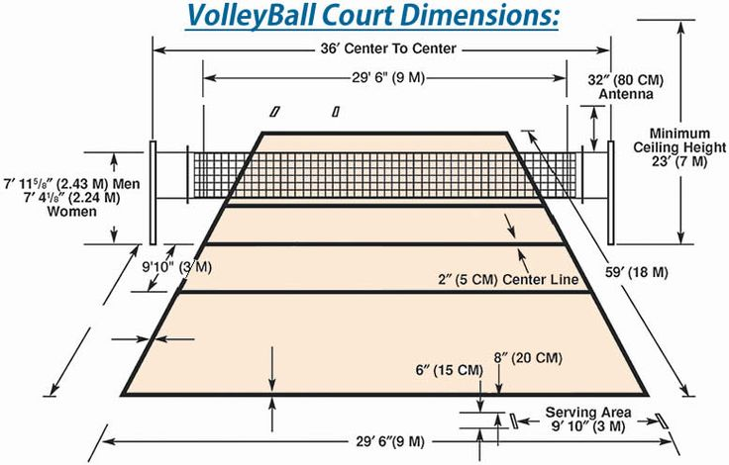
Volleyball Pitch

Slide 2
Type of Volleyball courts
There are two types of volley ball courts:--
1. Indoor
2.Outdoor

Slide 3
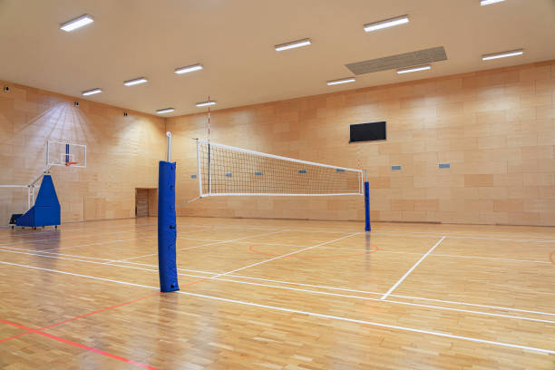
Indoor Volley ball
Uses of indoor volleyball:--
Structured Team Play
Faster Ball Movement
Consistent Environment
Diverse Play Styles
Safety and Comfort

Slide 4
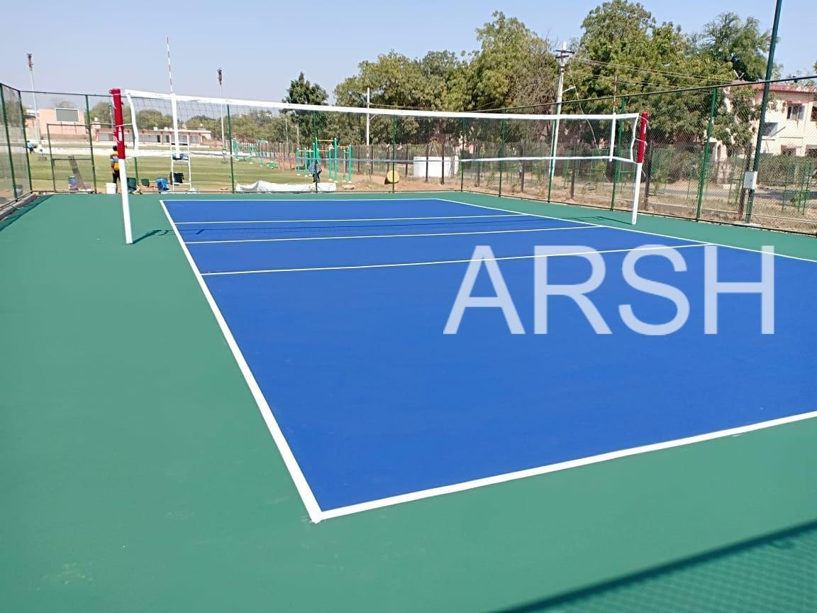
Outdoor Volley ball Court
Uses of outdoor volleyball:--
Full-Body Workout
Enhanced Agility and Balance
Natural Environment
Improves Hand-Eye Coordination

Slide 5
Design 50*26 feet Volleyball Court
Court Dimensions:-- Length: 50 feet
Width: 26 feet
Net:-- 1.Height: 7 feet 4 inches (2.24 mtr)(men's competition) or
7 feet (2.13mtr)(women's competition)
2.Width: 3 feet
Position: Centered on the court, dividing it into two halves
Baselines:
- Length: 17 feet
- Width: 3 inches
- Position: Along the width of the court, marking the out-of-bounds area
Sitting Area:--
- Length: 8 feet
- Width: 6 feet
Washroom:--
- Length: 8 feet
- Width: 10 feet
Cafeteria:--
- Length: 8 feet
- Width: 10 feet

Slide 6
26*50 ft Volleyball Court Design
3 ft service line
26 ft
24 ft
1 ft free space
17 feet
20 feet
50 ft
3 feet
Center line
1 ft
40 feet
Attack line
1 ft free space
Service line
1 ft free space
3 ft service line
8 ft
Cafeteria
Benches
washroom
8 ft
8 ft
10 ft
6 ft
10ft

Slide 7
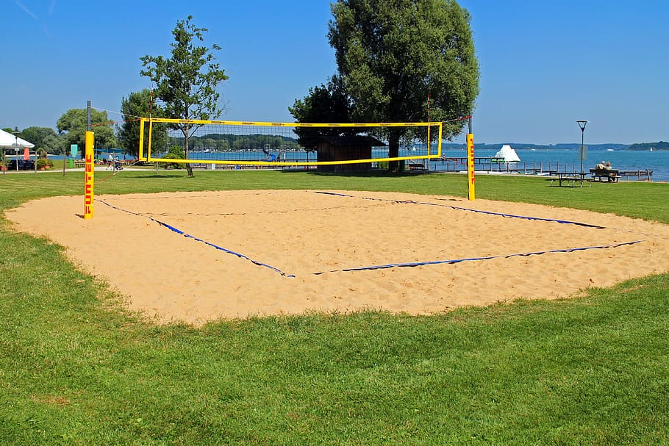
Floor sand
Advantages--
Soft Landing Surface
Low Impact on Joins
Beach Experience
Disadvantages:--
High Maintenance
Weather Dependency
Accessibility Issues

Slide 8
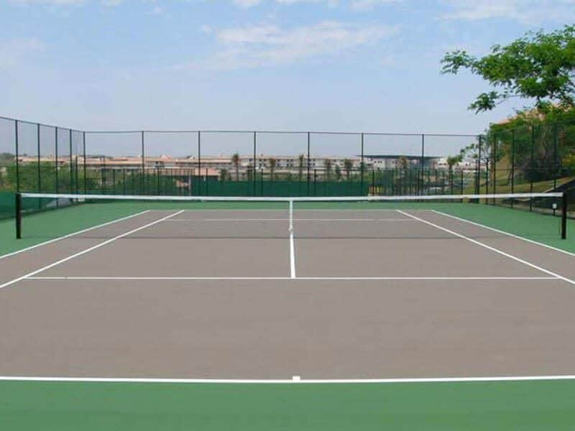
Floor Material Volley ball Court
Advantages:--
Durability
Low Maintenance
All-Weather Use
Disadvantages:--
Higher Initial Cost
Heat Retention
Less Natural Feel

Slide 9
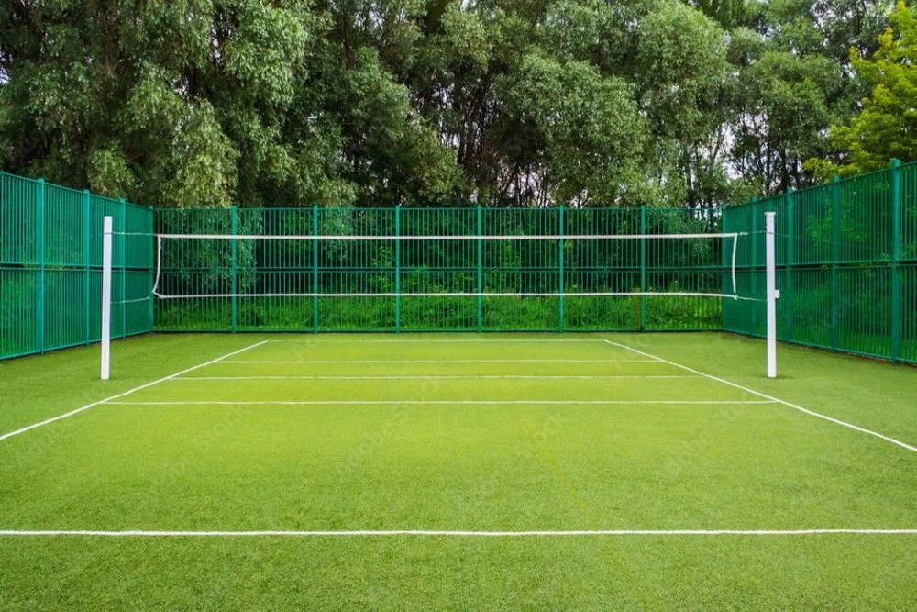
Floor Grass volley ball Court Design
Advantages:--
Natural Aesthetic
Cooling Effect
Multipurpose Use
Disadvantages:--
High Maintenance
Uneven Surface
High Maintenance

Slide 10
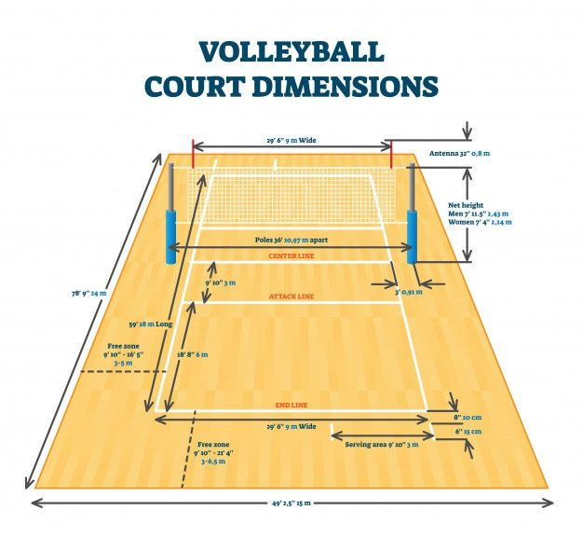
Floor Markers

Slide 11
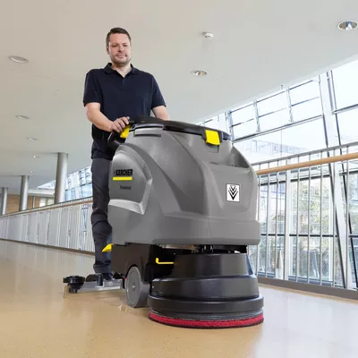
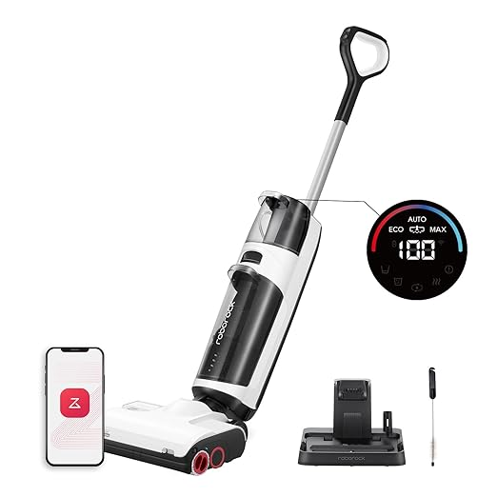
Volley ball court Floor Cleanup Equipments

Slide 12
Fencing Design
Types of polls:--
INDOOR VOLLEYBALL POLES
OUTDOOR VOLLEYBALL POLES

Slide 13
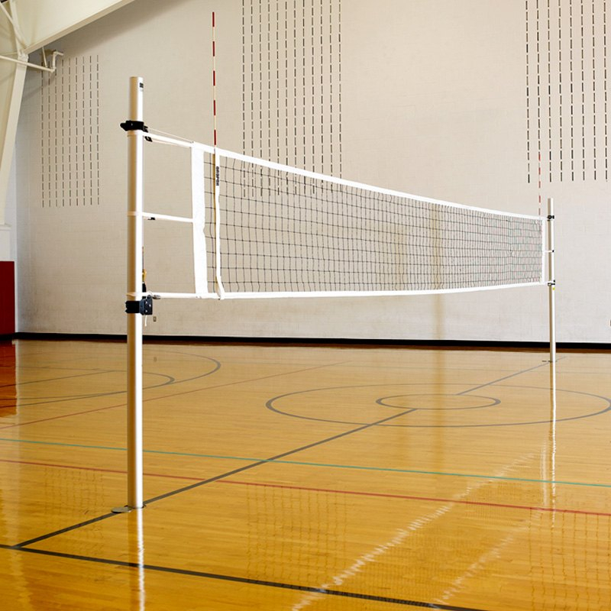
INDOOR VOLLEYBALL POLES

Slide 14
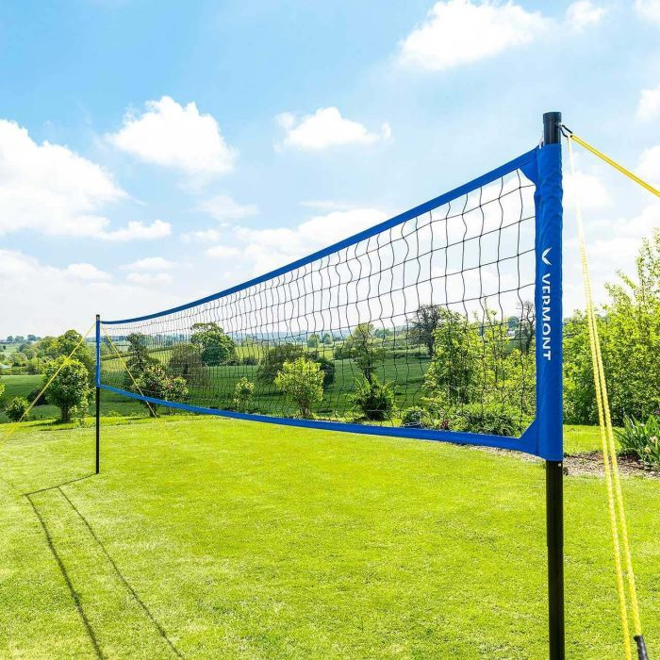
OUTDOOR VOLLEYBALL POLES

Slide 15
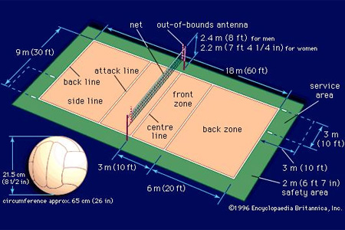
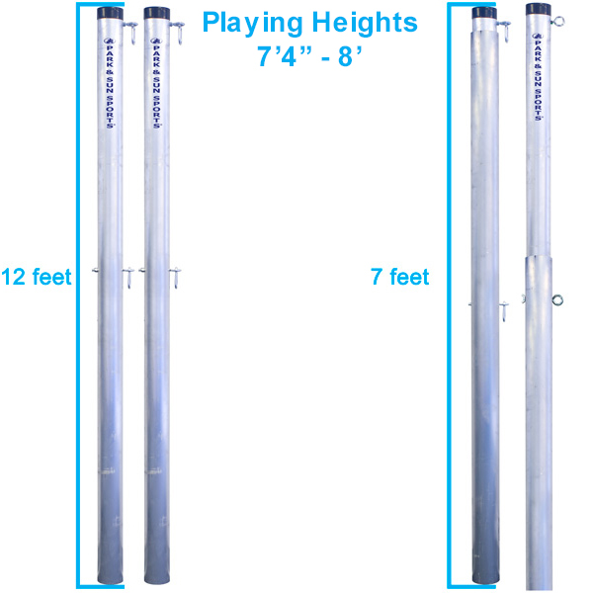
position of polls
No.of polls
Two poles are there in volleyball.

Slide 16
Types Of Nets
Indoor volleyball nets:--
Senoh HM50 Indoor Volleyball Net
Senoh FIVB Approved Indoor Volleyball Net
Sitting Volleyball Net
Mini Volleyball Net
outdoor volleyball nets:--
Beach Volleyball Net 28 feet or 32 feet
Recreation Outdoor Volleyball Net 32 feet
Senoh FIVB Approved Beach Volleyball Net

Slide 17
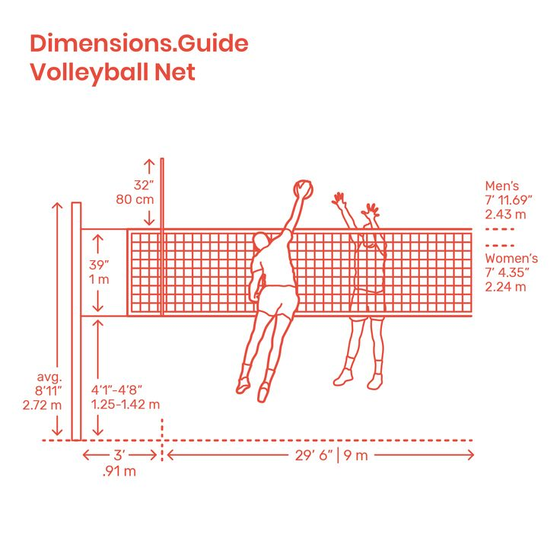
No of Nets & Length of Nets
Position of Nets
Net Height for Men :
2.43m (7.11F)
2. Net Height for women :
2.24m (7.4F)

Slide 18
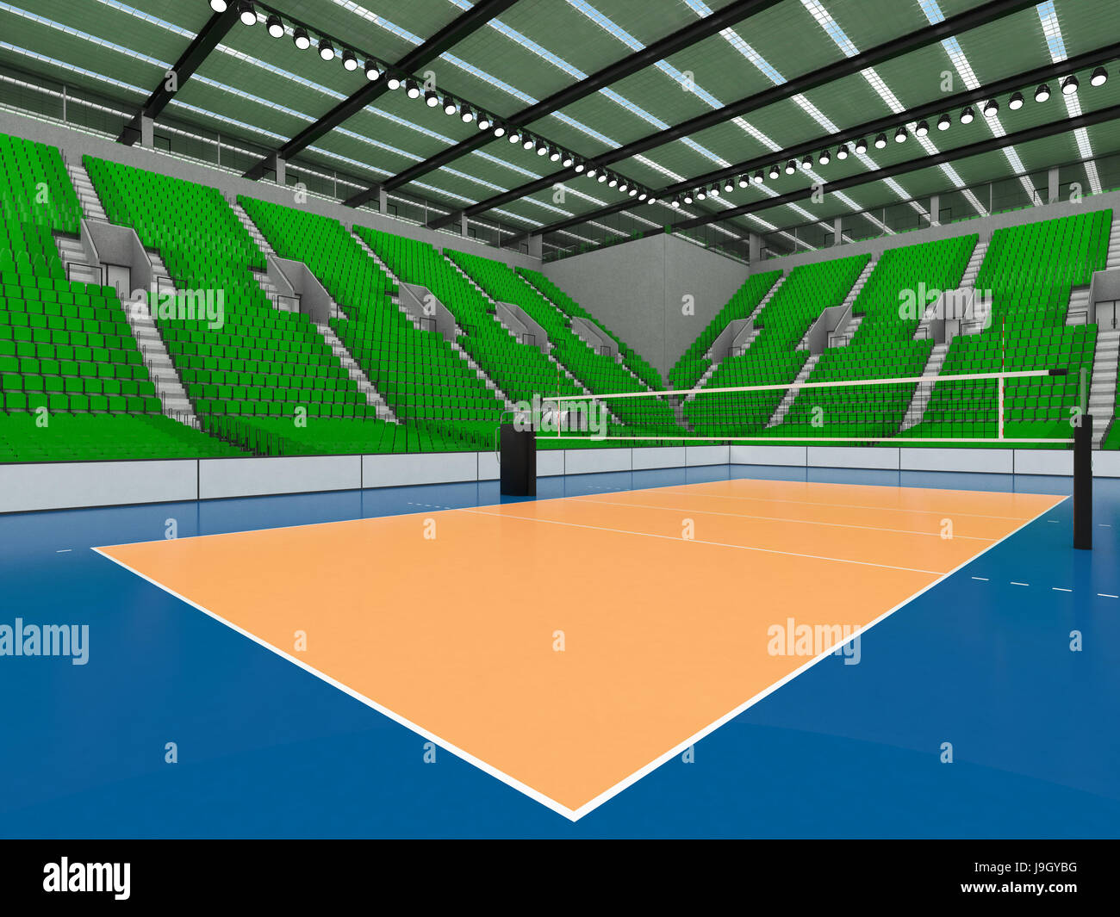
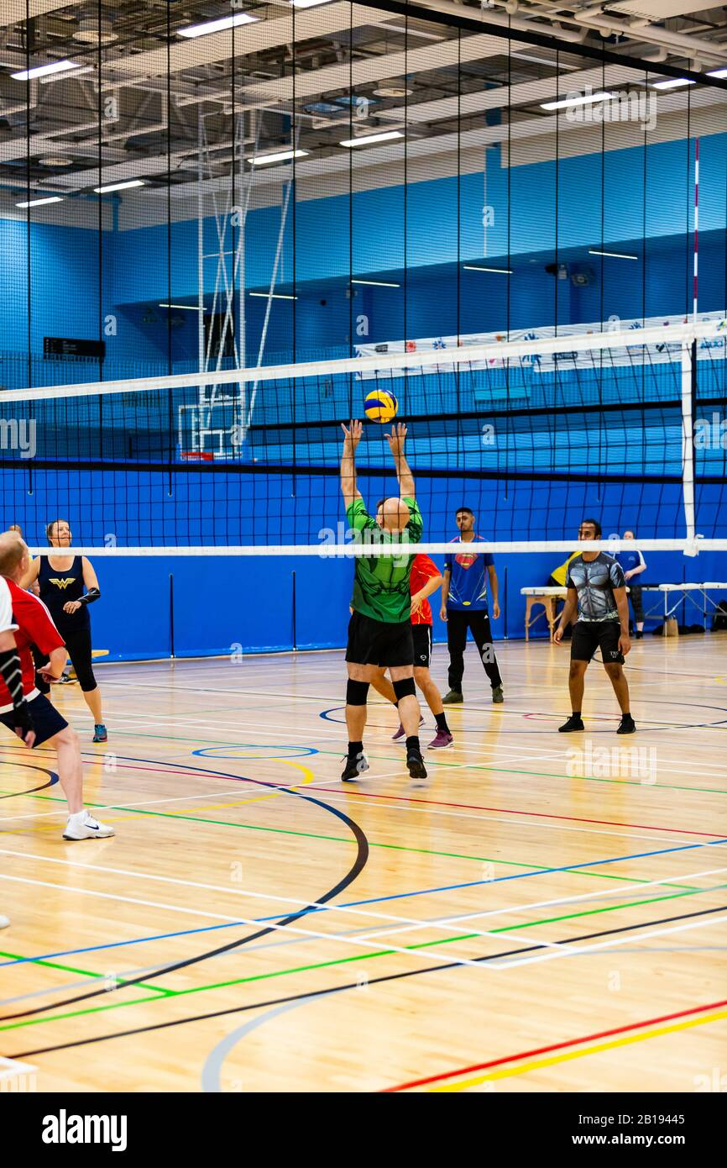
Top Roof for Rain Season
II . Aluminum coated roof sheet
Plastic roofing

Slide 19
Surronding Water Flow
Types of fixes:--
Single fixes
Cumulative PTF packages
Fix groups
Service packs

Slide 20
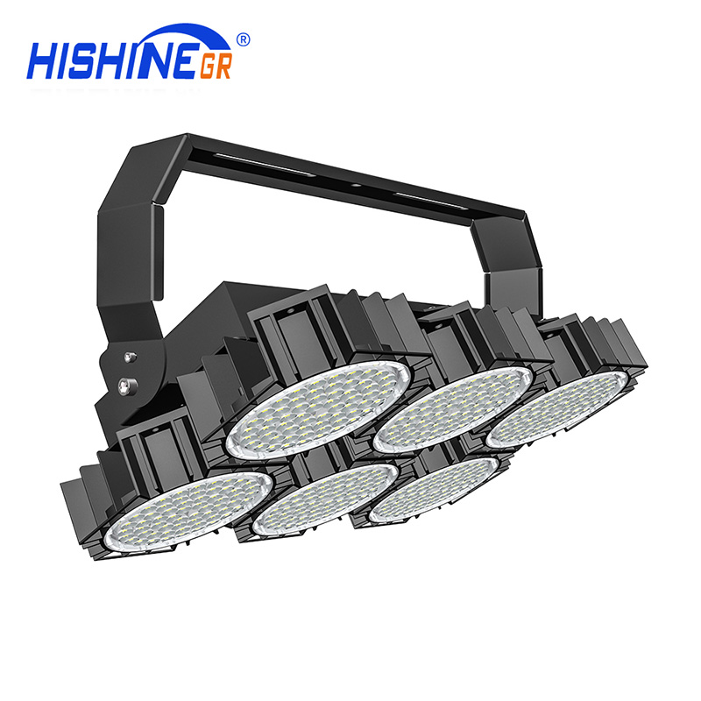
Lightining for Nights
Types of lights :--
For a long time, the most popular type of lighting system used for volleyball courts was metal halide lighting systems. However, in the last decade LED sports lighting systems have taken over as the number one choice on the market.
These fixtures are the most common type found at volleyball courts because they provide uniform and quality illumination with a focused beam angle for the court below.

Slide 21
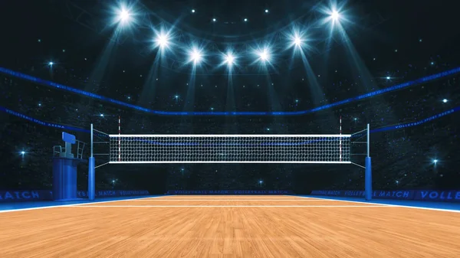
No.of Lights
No.of lights:--
For recreational and club-level volleyball play, 7 to 20 footcandles is appropriate in most cases. For competition or professional level, up to 50 footcandles is typically utilized.

Slide 22
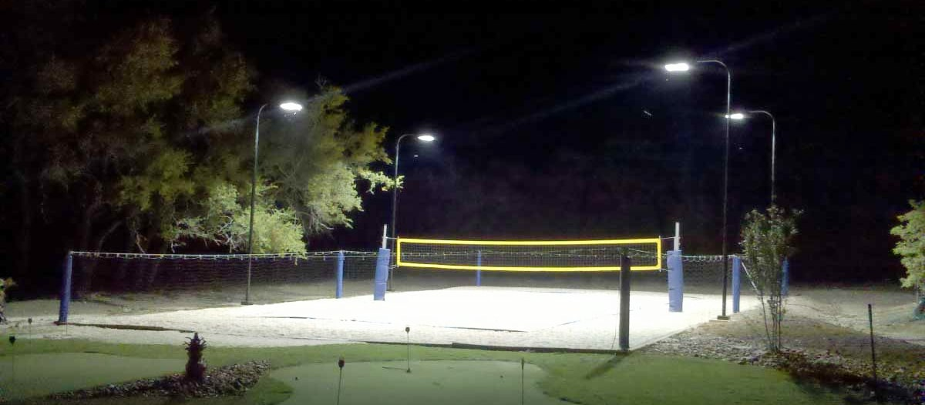
Position of Lights
Location and height of light fixtures:--
The FIVB recommends a mounting height of at least 12 meters (39 feet) for indoor courts and at least 8 meters (26 feet) for outdoor courts.
In order to provide even illumination across the court, the fixtures should be placed
around the perimeter of the playing area

Slide 23
Focus of Lights
To have proper lighting in your volleyball court, you need to focus on the poles required in the field. The courts have different pole arrangements- 4 poles, 8 poles, etc.
Not only this, but the heights of the pole also vary. If your volleyball court has tall poles, then you will need fewer poles.

Slide 24
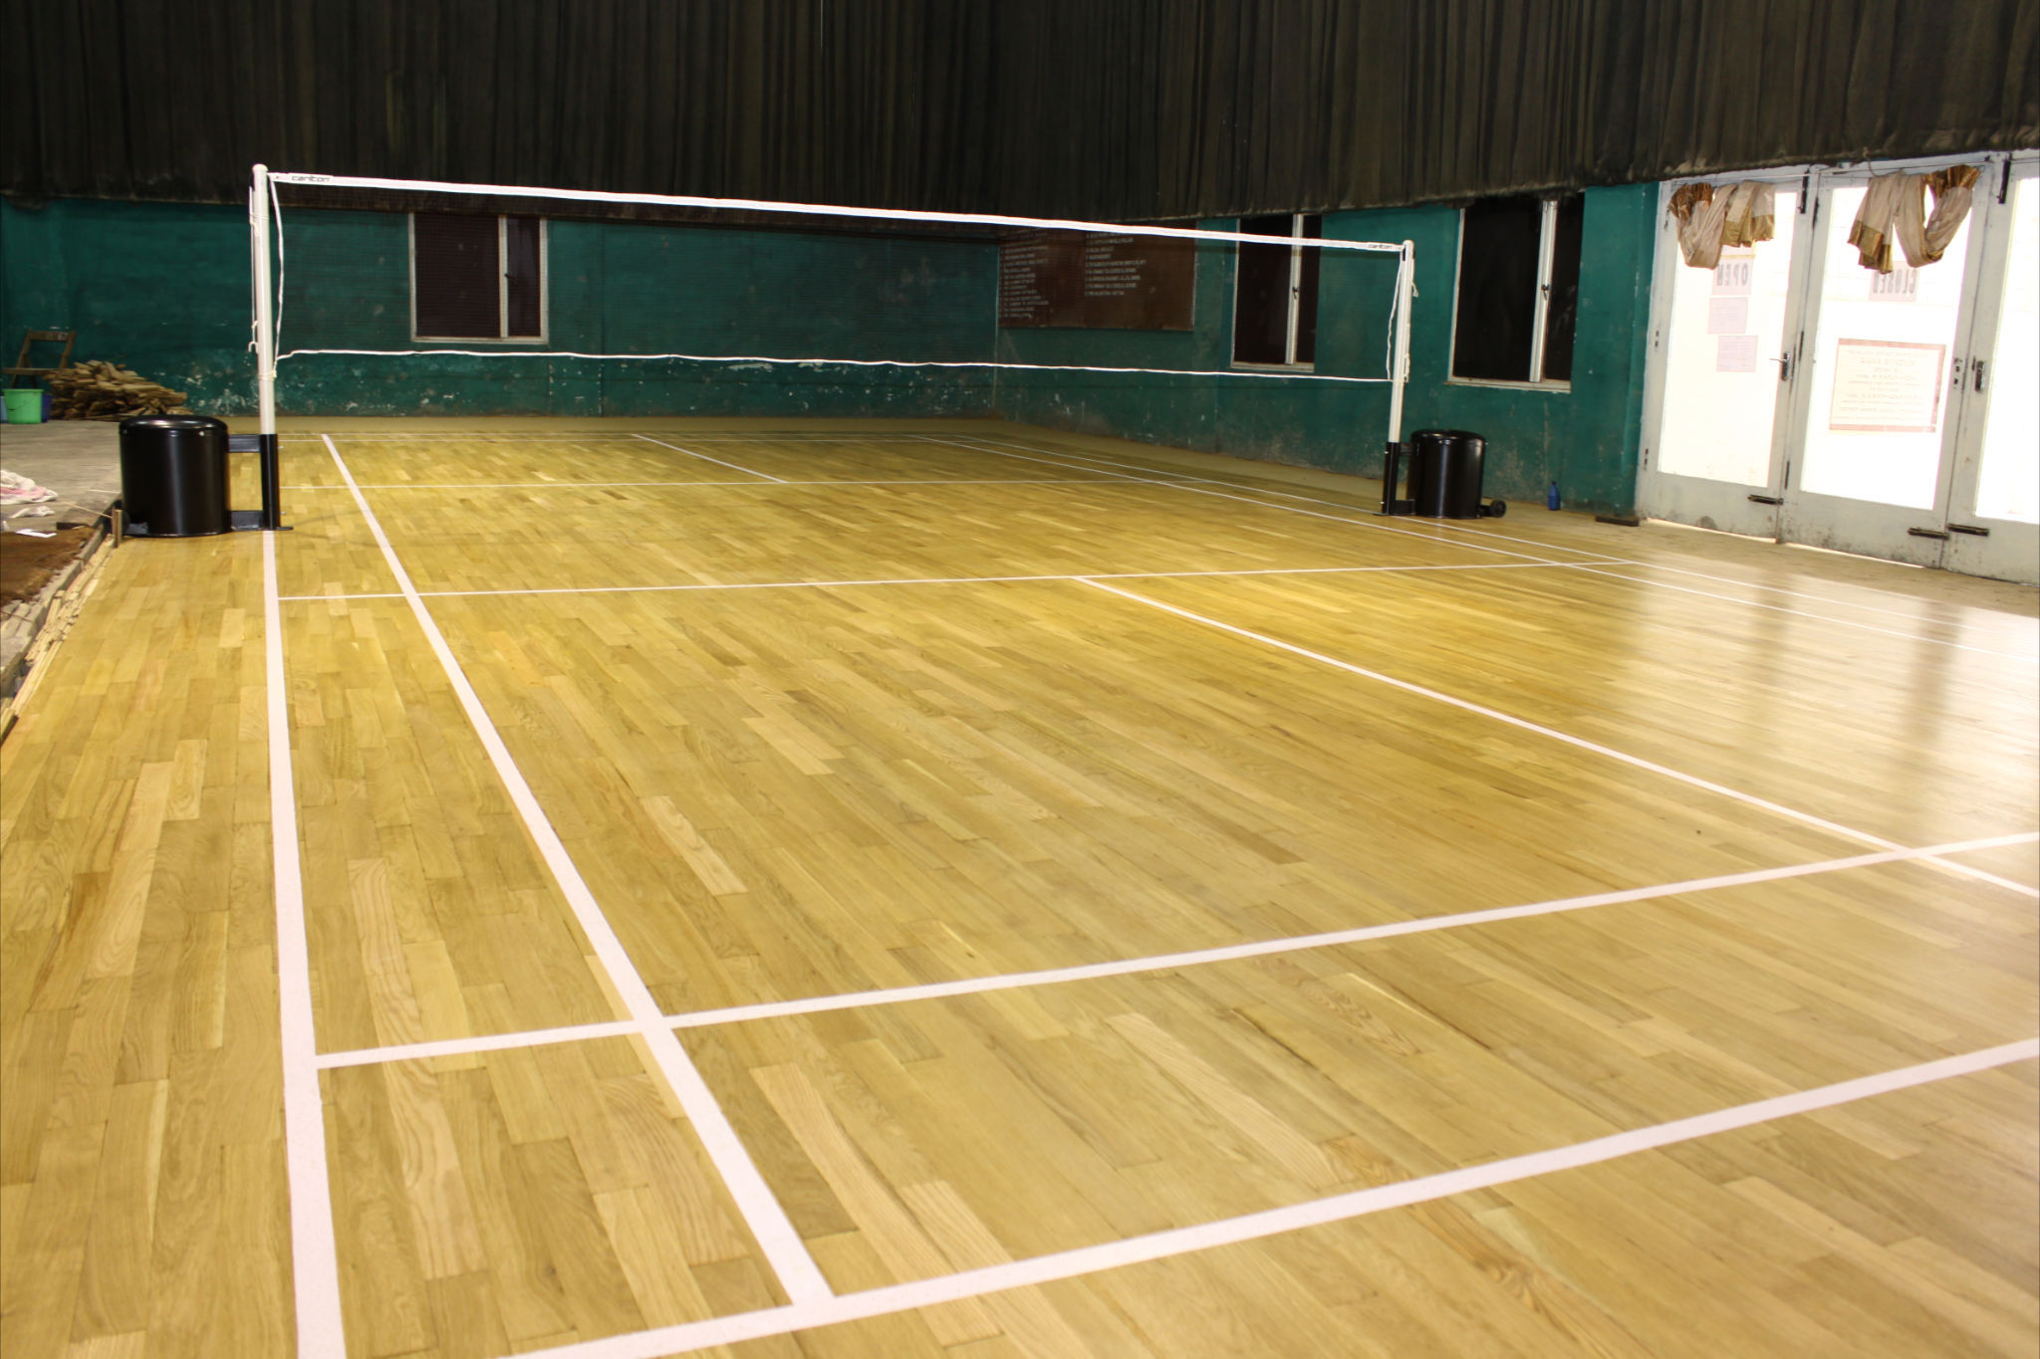
Play Ground Matt
Wooden Play Ground Matt
Most commenly used ground matts are:
Wooden
PVC
Vinyl
Types of Matt

Slide 25
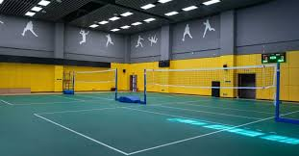
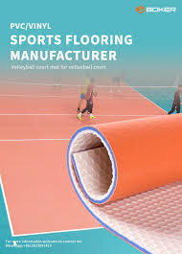
Types of Matt
Vinyl Play Ground Matt
PVC Play Ground Matt

Slide 26
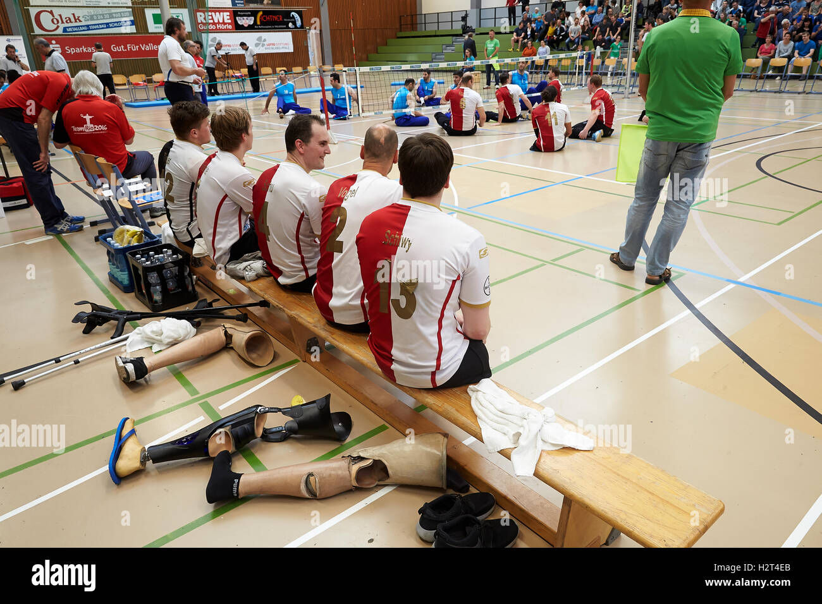
Sitting Area
6*8 feet sitting area for volleyball court

Slide 27
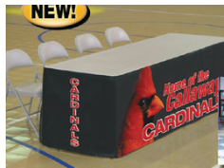
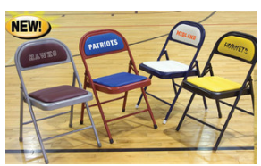
Types of Tables and Chairs

Slide 28
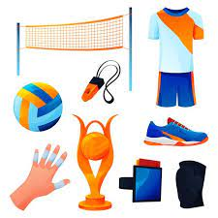
Types Of Equipments in Volleyball
Types of equipments :--
Volleyball balls
Volleyball shorts
Volleyball t-shirts
Volleyball braces, sleeves and pads
Volleyball court
Volleyball net and poles
Volleyball penalty cards

Slide 29
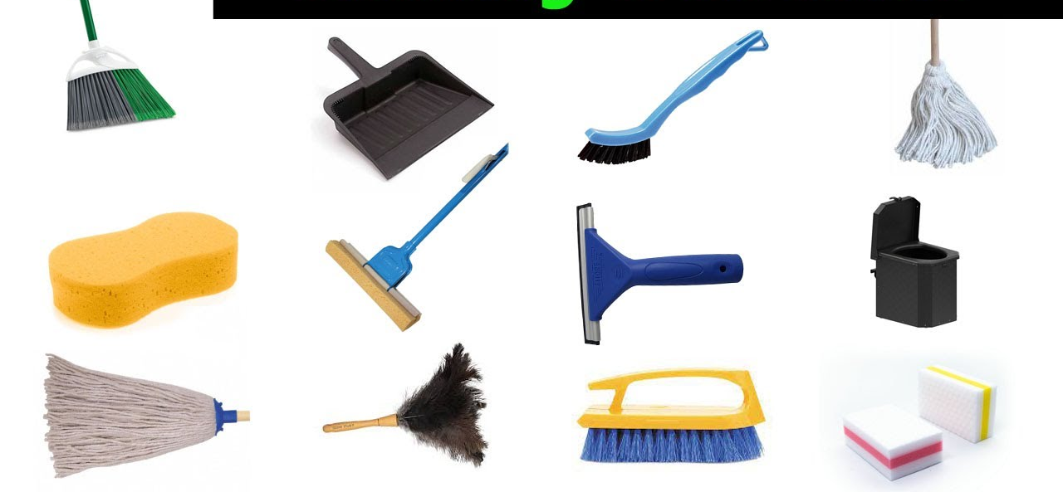
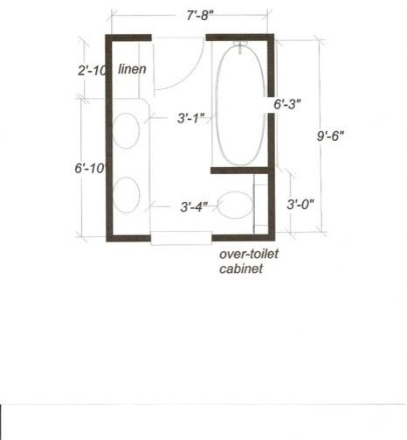
Washroom Design
Washing Equipment
Design & Measurements

Slide 30
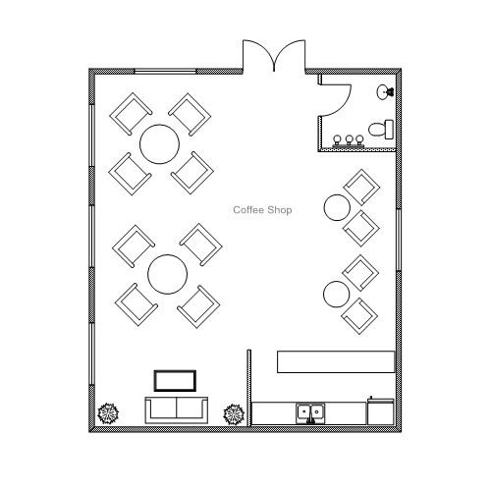
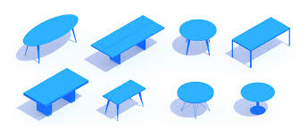
Cafeteria Design
Cafeteria Design & Measurements
Relaxing equipment
8 feet
10 ft

